Slide 1
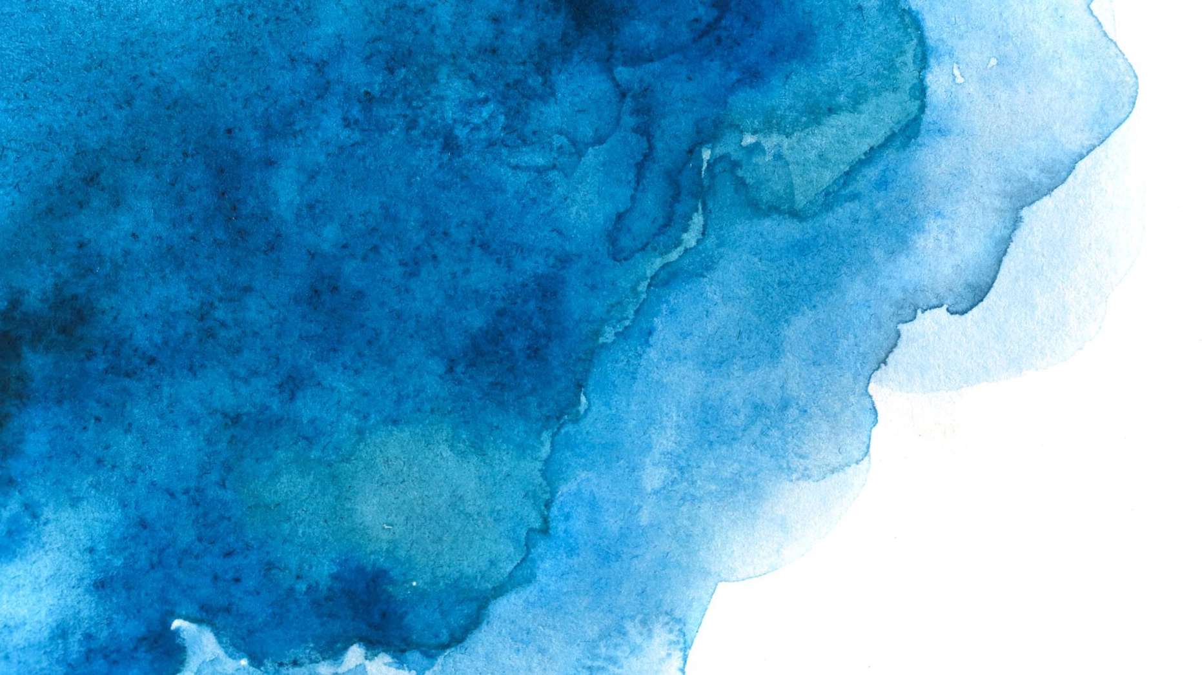
A Short Biography of Myself
Riha Rahman
Registration Number : 2020236053
Department of English
Shahjalal University of Science and Technology, Sylhet

Slide 2
GENERAL INFORMATION
Name : Riha Rahman
Born : 22 February, 2002
Birthplace : Sylhet
Father's Name : Muhammad Luthfur Rahman
Mother’s Name : Rabeya Akther
Blood Group : O+
MBTI :INFP

Slide 3


FAMILY
Father
Professor
Mother
Housewife
Me
Eldest
Younger
Sister
Student
Youngest
Sister
Student

Slide 4
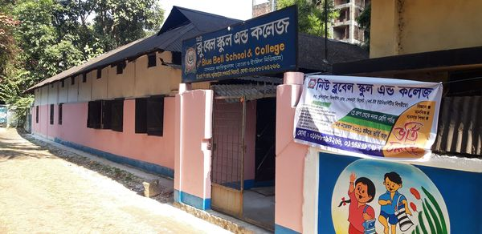
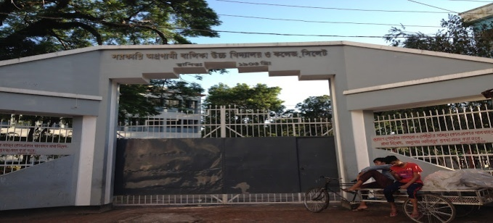
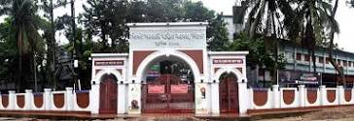
EDUCATIONAL BACKGROUND
Bluebell Kindergarten School, Sylhet.
Play-Class 1
Govt. Agragami Girls High School and College, Sylhet.
Class 3-Class 10
Sylhet Govt. Women’s College, Sylhet.
Class 11-Class 12

Slide 5




WHAT I LIKE TO DO
Collecting & Reading Books
Watching Shows & Movies
Journaling
Travelling
Painting

